Slide 1
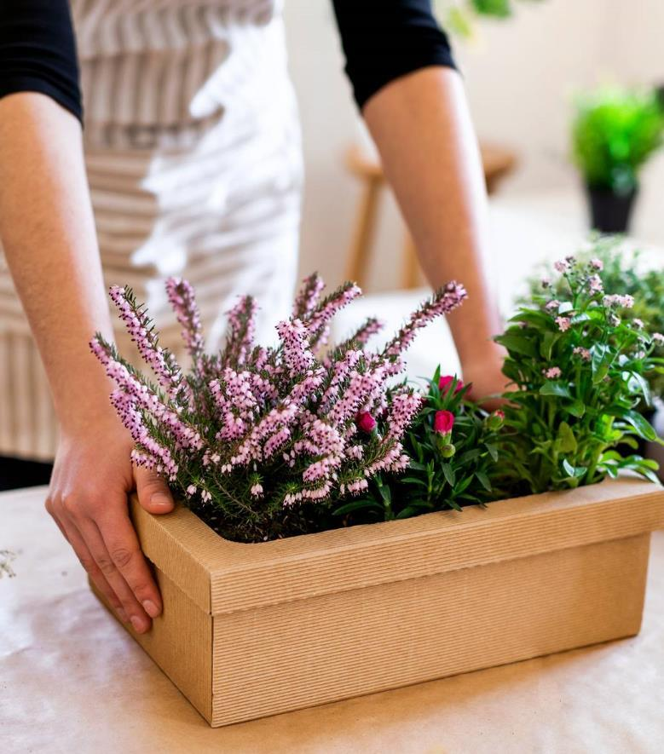
Comprehensive Audit And Analysis For Effective Digital Presence

Slide 2


Table of Content
Problem Statement
Introduction
Website Audit
Digital Marketing strategy
Website creation

Slide 3

Problem statement
This project aims to audit the website's current digital strategy and recommend actionable improvements to strengthen its online impact and conversion potential.

Slide 4

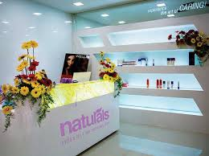
Introduction
Company Name: Naturals Salon
Website: https://www.naturals.in
Industry: Beauty & Personal Care Services
Naturals Salon is a prominent player in India’s beauty and personal care industry, operating over 700 salons across the country.
The brand offer a wide range of beauty services and provides a franchise program that allows individuals to become business owners within the beauty industry.

Slide 5

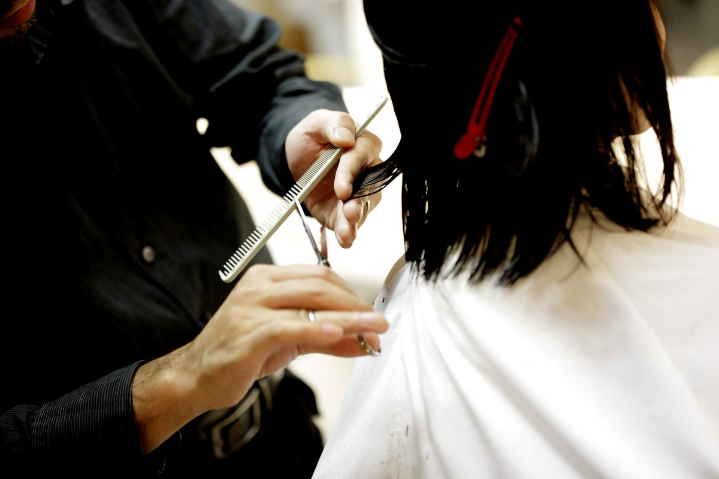
Website Audit Report
Overview:
A detailed digital audit was performed on Naturals to assess its strengths and gaps across core areas of online performance — including SEO, user experience, and competitive positioning.
The objective was to uncover actionable insights that can help Naturals improve visibility, drive online engagement, and stay ahead in a digitally evolving beauty industry.
Audit report

Slide 6

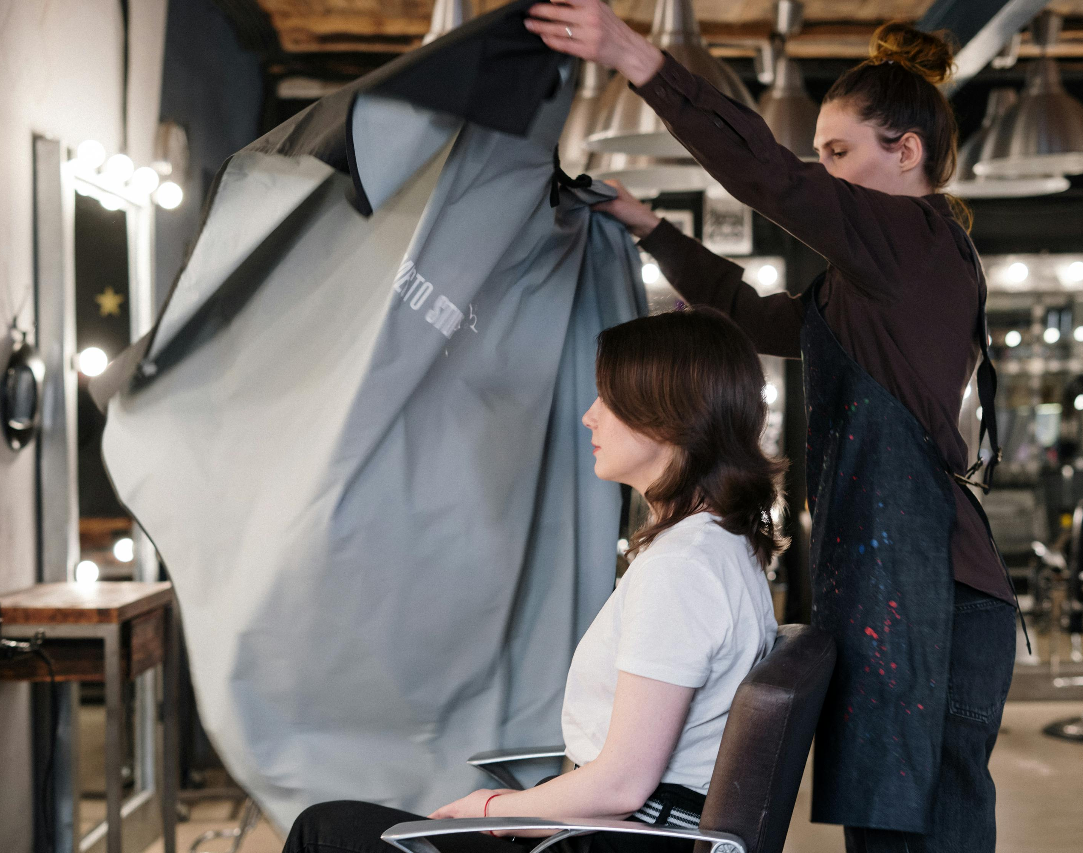
Digital Marketing Strategy
The digital marketing strategy is to transition Naturals Salon from primarily traditional marketing methods to digital-first approaches.
This shift will help enhance online presence, increase customer engagement, and generate measurable leads and bookings through targeted digital channels.

Slide 7

Traditional vs. Digital marketing goals
Traditional marketing
Digital marketing
Build local awareness through physical visibility
High cost per campaign (printing, distribution)
One-way communication (ads, posters)
No visibility into touchpoints
Drive online engagement, bookings, and brand discovery
Cost-effective (CPC, retargeting, flexible budgeting)
Two-way engagement (comments, DMs, reviews, shares)
Full funnel tracking (impressions to conversions)
While traditional marketing builds local visibility, digital marketing offers cost-effective, measurable, and scalable strategies. Adopting digital channels helps Naturals reach a broader and more targeted audience beyond physical boundaries.

Slide 8

Recommendations:
SEO Optimization-
Naturals should try to rectify the mistakes that was pinpointed in audit for SEO ranking since the digital presence is predominant nowadays.
Channel : Start a branded channel with bridal looks, hair care tips, customer stories
Reviews: Encourage customer reviews with location tags
Content Marketing :Blog post for Content Marketing
Churn Retention:
Monitor churn rate and offer loyalty benefits or re-engagement campaigns
FAQ : FAQs with dropdowns for easy reading
Offers : Limited-Time Online Offers

Slide 9
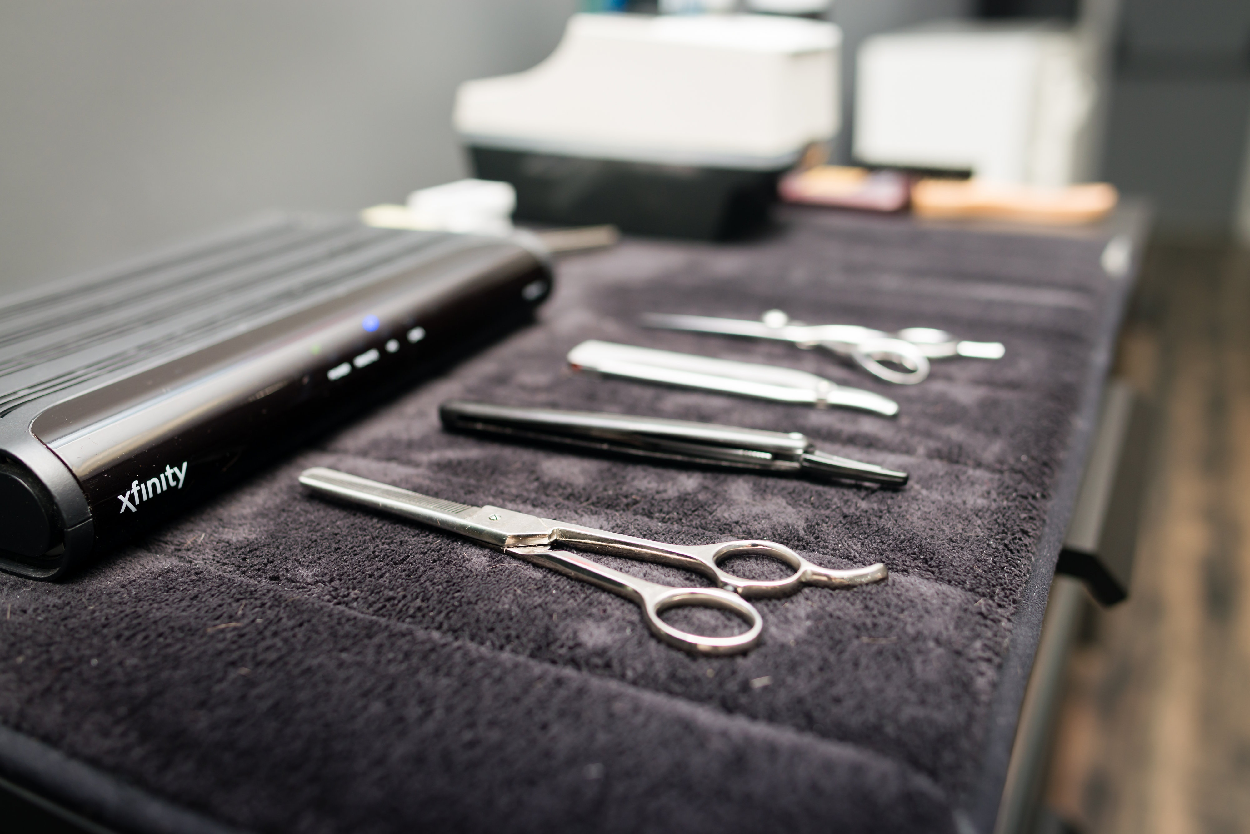
Website Development
The website has been created via Wix using the skills and knowledge I’ve gained so far.
While it is a learner-level site, it demonstrates practical application of web development tools and aligns with the digital strategy recommendations outlined in the audit.
It reflects my understanding of key web elements such as layout, navigation, and content placement.
Website link

Slide 10
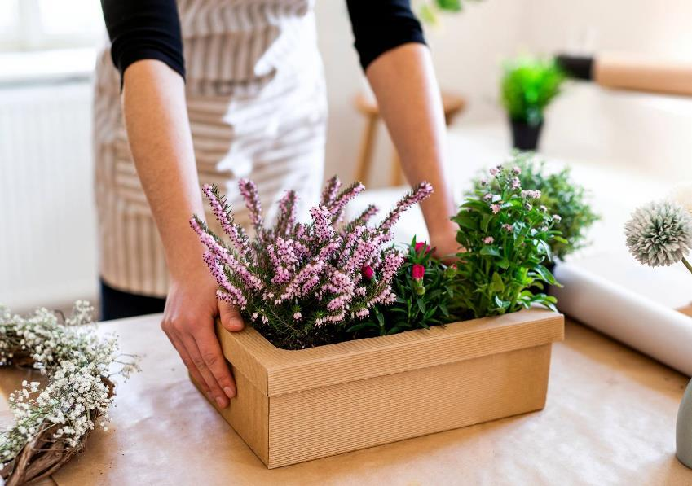

Thank you

